Slide 1



人工智能核心能力培养 — Lecture 04
Metric, Evaluation, Data Preprocessing
高民权

Slide 2

review
What is model?
What’s linear regression?
What’s logistic regression?
How to implement linear and logistic regression from scratch?

Slide 3
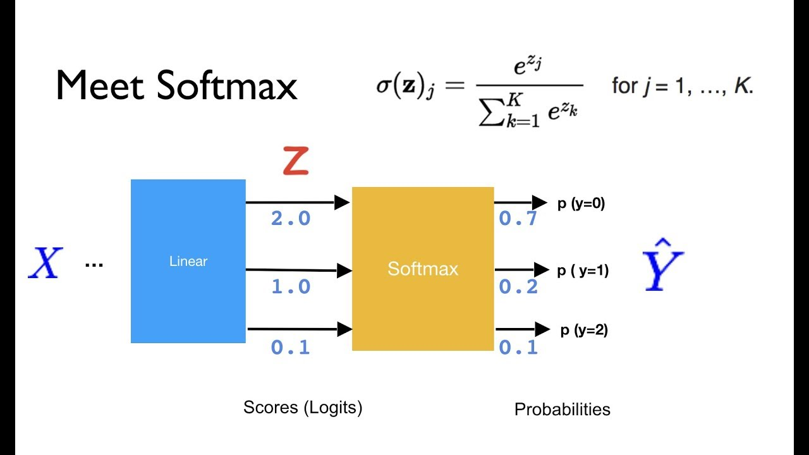
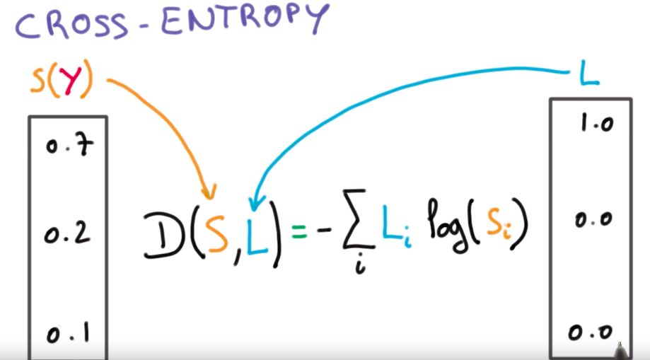
Logstic regression loss function
Cross-entropy loss for categorical classification

Slide 4
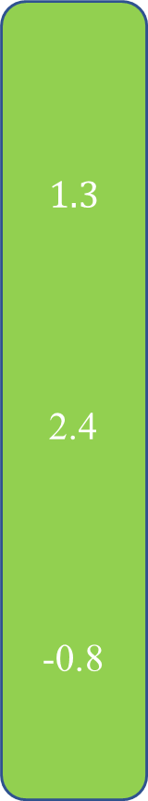



Pipie line of classification (deep learning classification)
$$\vec{x}$$
$$1.3$$
2.4
-0.8
$$0.24$$
0.72
0.023
$$0$$
1
0
cross-entropy
F(x)
softmax
wx + b
Y-true

Slide 5
评测指标 Evaluation and metric
找到正确的评测指标，机器学习任务就成功了一大半
The right indicators make machine learning task more than half successful.

Slide 6
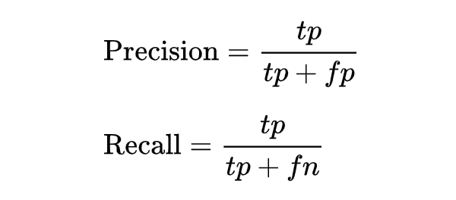
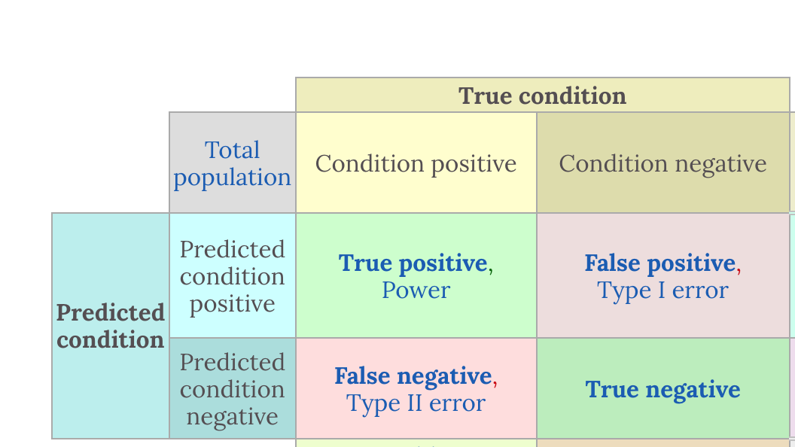
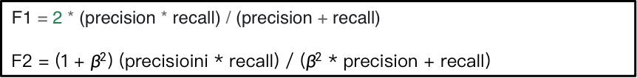
How to evaluate?
Baseline?
Regression:
Accuracy
Absolutely Accuracy Percentage
R2-Score
Classification:
Accuracy
Precision
Recall
ROC/AUC
F1_score, F2_score
F1 = 2 * (precision * recall) / (precision + recall)
F2 = (1 + $β^{2}$) (precisioini * recall) / ($β^{2}$ * precision + recall)

Slide 7
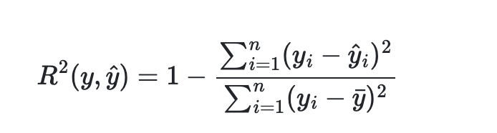
Y-true | 1.0 | 1.2 | 1.5 | 0.9 | 0.5 | 1.4
 | Mean | 1.08
Y-hat | 1.2 | 1.8 | 1.3 | 1.0 | 0.9 | 1.3
 | Mean Absolute Percentage Error | 0.36
 | R2-scoree | -0.36
Y-hat | 1.0 | 1.8 | 1.3 | 1.0 | 0.9 | 1.3
 | Mean Absolute Percentage Error | 0.30
 | R2-scoree | 0.07
Y-hat | 1.08 | 1.08 | 1.08 | 1.08 | 1.08 | 1.08
 | Mean Absolute Percentage Error | 0.34
 | R2-scoree | 0
如何解读？

Slide 8
Observed Objects
P1
P2
G | B | G | G | G | B
G | G | G | G | G | G
G | G | B | B | G | G
G | G | G | G | G | B
G | G | B | G | G | G
G | G | G | G | G | G
G | G | G | G | G | G
G | G | G | G | G | G
G | G | G | G | G | G
G | G | G | G | G | G
G | G | G | G | G | G
G | G | G | G | G | G
B | B | B | B | B | B
B | B | B | B | B | B
B | B | B | B | B | B
B | B | B | B | B | B
B | B | B | B | B | B
B | B | B | B | B | B
P3
P4
P5
G | G | G | G | G | B
G | G | G | G | G | B
G | G | B | B | G | G
G | G | G | G | G | G
G | G | B | G | G | G
G | G | G | G | B | B
G | G | G | G | G | B
G | G | G | G | G | G
G | G | B | B | G | G
G | G | G | G | G | G
G | G | B | G | G | G
G | G | G | G | G | B
G | G | G | G | G | G
G | G | G | G | G | G
G | G | G | G | G | G
G | G | G | G | G | G
B | B | B | B | B | B
B | B | B | B | B | B

Slide 9
Question
A | B | A | B
A | A | B | A
B | B | B | B
A | A | B | A
A | B | A | A
A | B | A | B
B | A | B | B
B | B | A | B
A | A | A | B
A | A | B | A

Slide 10
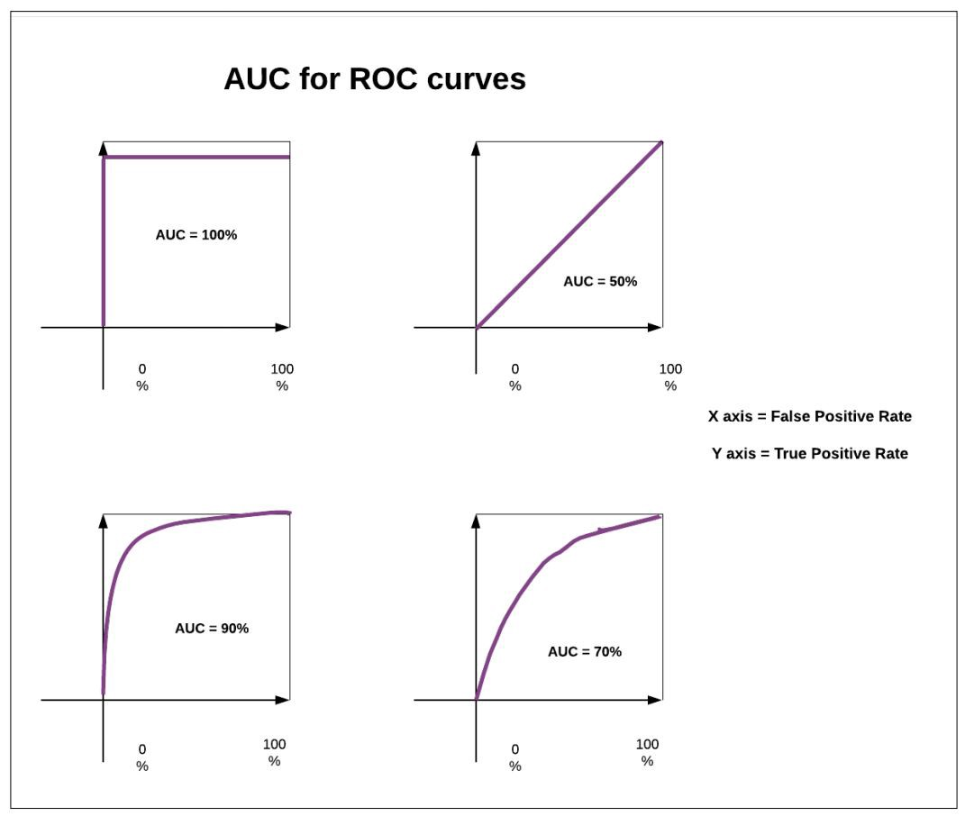
Auc for very unbalanced data

Slide 11
Question
A | B | A | B
A | A | B | A
B | B | B | B
A | A | B | A
A | B | A | A
A | B | A | B
B | A | B | B
B | B | A | B
A | A | A | B
A | A | B | A
A | B | A | B
A | A | B | A
B | A | A | A
B | B | A | A

Slide 12
A | B | A | B
A | A | B | A
B | B | B | B
A | A | B | A
A | B | A | A
B | B | B | A
B | B | A | A
B | B | A | A
B | A | A | A
A | B | B | B

Slide 13
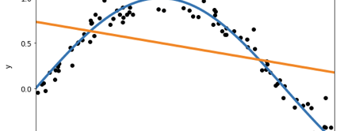
Overfitting & Underfitting
Why?

Slide 14
Outliner
What’s outliner and how to detect?
Percentile（25 percentile, 75percile）

Slide 15
Bias and Variance
Dilemma
The bias is an error from erroneous assumptions in the learning algorithm. High bias can cause an algorithm to miss the relevant relations between feature and target outputs. (underfitting);
The variance is an error from sensitivity to small fluctuations in the training set. High variance can cause an algorithm to model the random noise in the training data, rather than the intended outputs (overfitting).

Slide 16
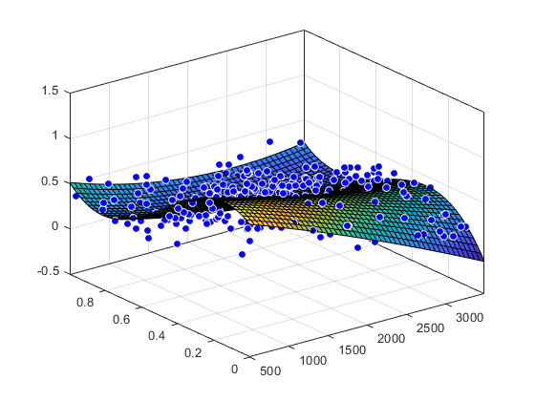
Dimension curse 维度灾难
The more dimension
The more and more … data need
过拟合 Overfitting | 欠拟合 Underfitting
训练数据占总体数据过少 | 训练数据占总体数据过多
模型过于复杂 | 模型过于简单
采样过于不均衡 | 采样过去全部
没有正则化 …

Slide 17
Train, validation, test
Good Memory V.S Good Learning

Slide 18
Train, validation, test
Good Memory V.S Good Learning

Slide 19

New
Data
特征提取
Feature extractor
Framework 机器学习的通用框架
x
1
3
2
Observed
Data
$$θ$$
Loss function
特征提取
Feature extractor
向量
vector
学习
Learning
f
Acc / precision
X1 = [0.1, 0.21,
0.33, 0.98]
Y1 = [0, 0, 1]
4
y
X2 = [0.23, 0.98,
0.33, 0.98]
Y2 = 0, 1, 0]
Gradient Descent
X3 = [0.143, 0.87,
0.1 0.98]
Y3 = [1, 0, 0]
What’s the difference of Supervised Learning and Unsupervised Learning?

Slide 20

Feature scaling
Training data split
Normalization
Standardized
One-hot

Slide 21

数值归一化和标准化 Normalization and standardized

Slide 22
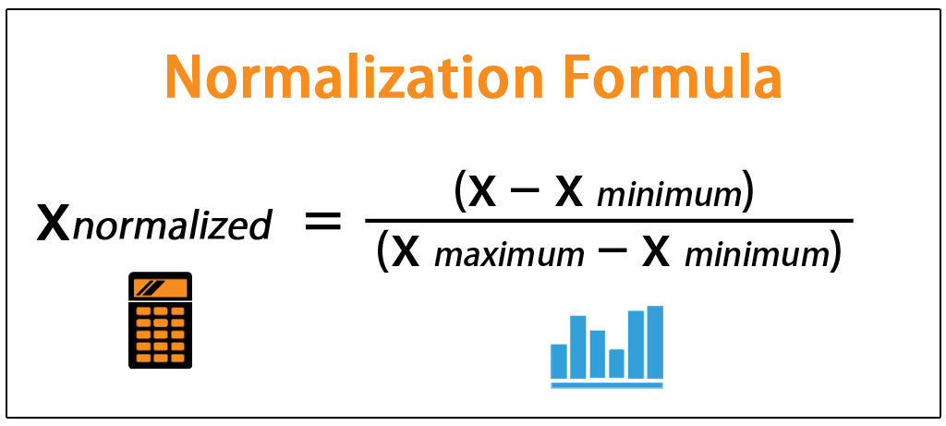
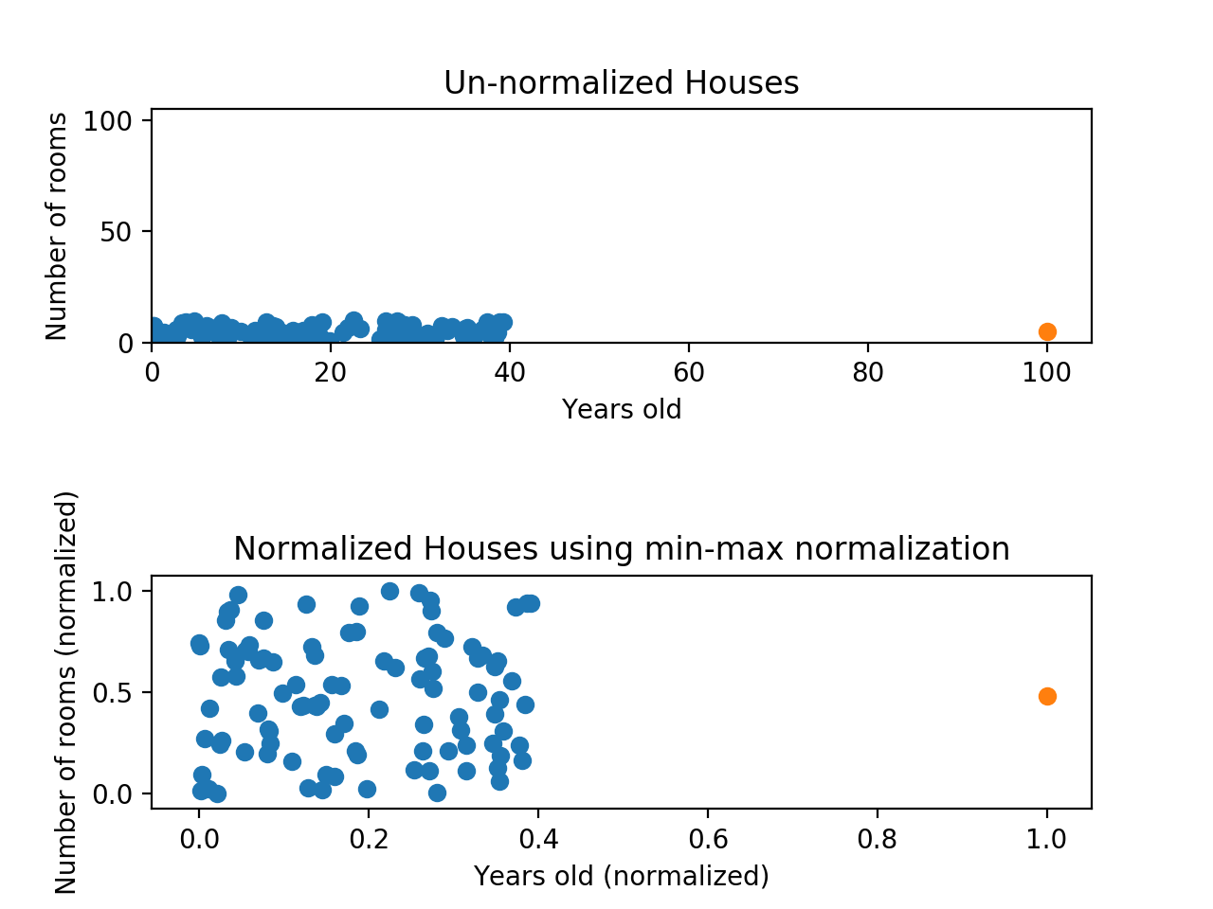
Max-min scalar (normalize)

Slide 23
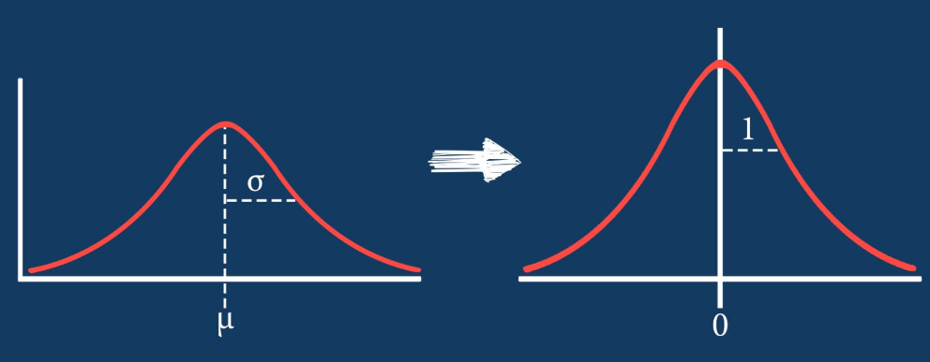
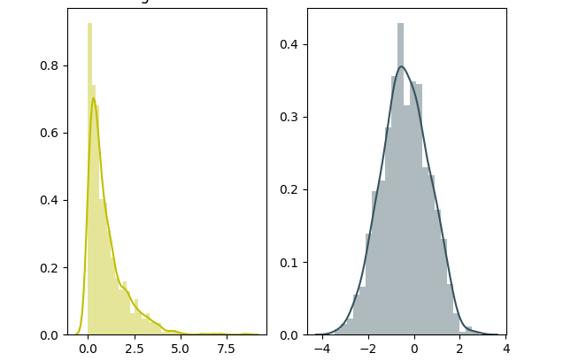
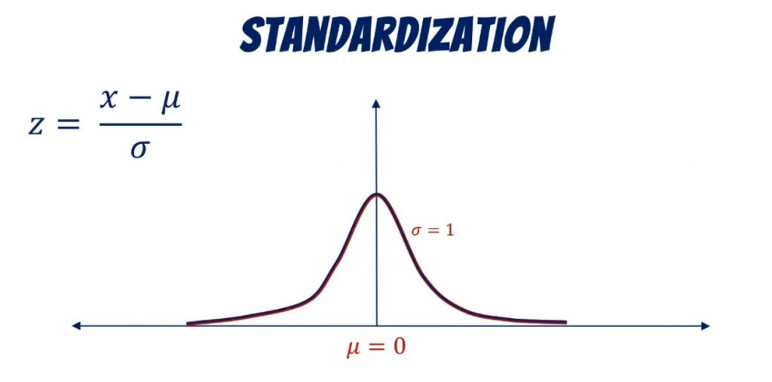
Data standardized (normalize)

Slide 24
The problem from homwwork: One-hot coding
All are numbers

Slide 25
Categorical & Numerical
What’s the different?

Slide 26
Categorical
Could not be compared
Could not be sorted
The Number just is a
representation
Numerical
Could be compared
Could be sorted
The number with attribute

Slide 27
Why it counts?

Slide 28
One-Hot and Embedding

Slide 29

Programminig 04-01
>>> one-hot
>>> normalization

Slide 30

NOW are are read for a whole classification task
现在我们已经做好准备解决完整的分类问题了

Slide 31
Programming-04-02 Linear regression principle and method
>>> implement linear regression solve house price problem
>>> the scikit learning for linear regression

Slide 32
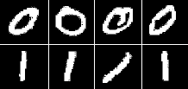
Programming – 04- 02 Binary classification problem
Scikit learning solve binary digital classification
With metrics

